Slide 1
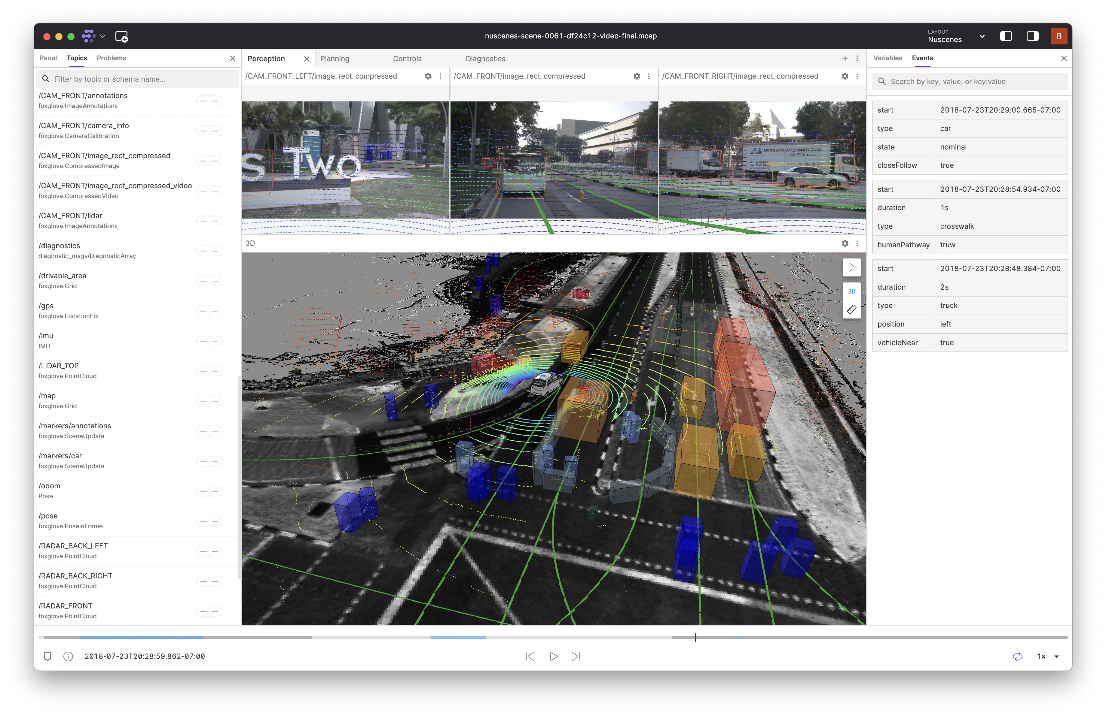
Scene Classification and Visualization Tools Design Based on Waymo Dataset
Presented By: Jingjie Qian, Malia Howe, Rongxuan Zhou

Slide 2
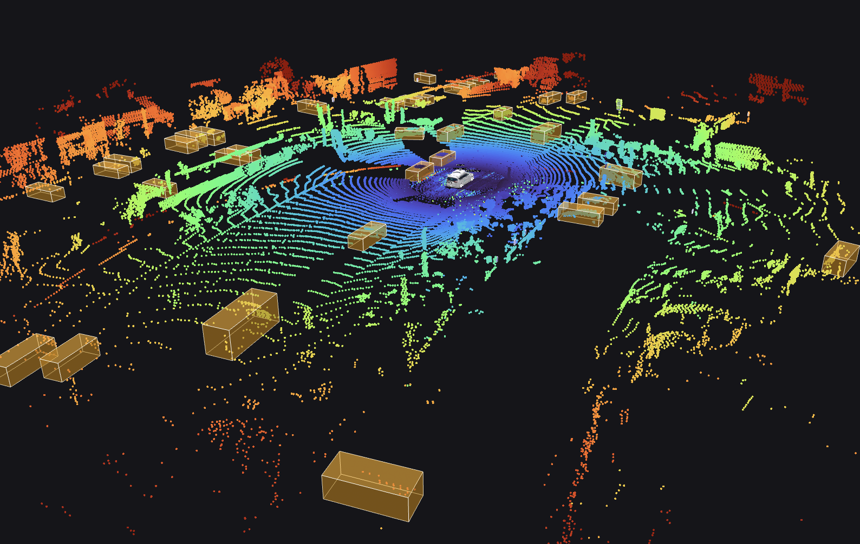
Contents
01. Problem Description
02. Motivation
03. Proposed Technical Approach
04. Expected Outcomes

Slide 3
Problem Description
01

Slide 4
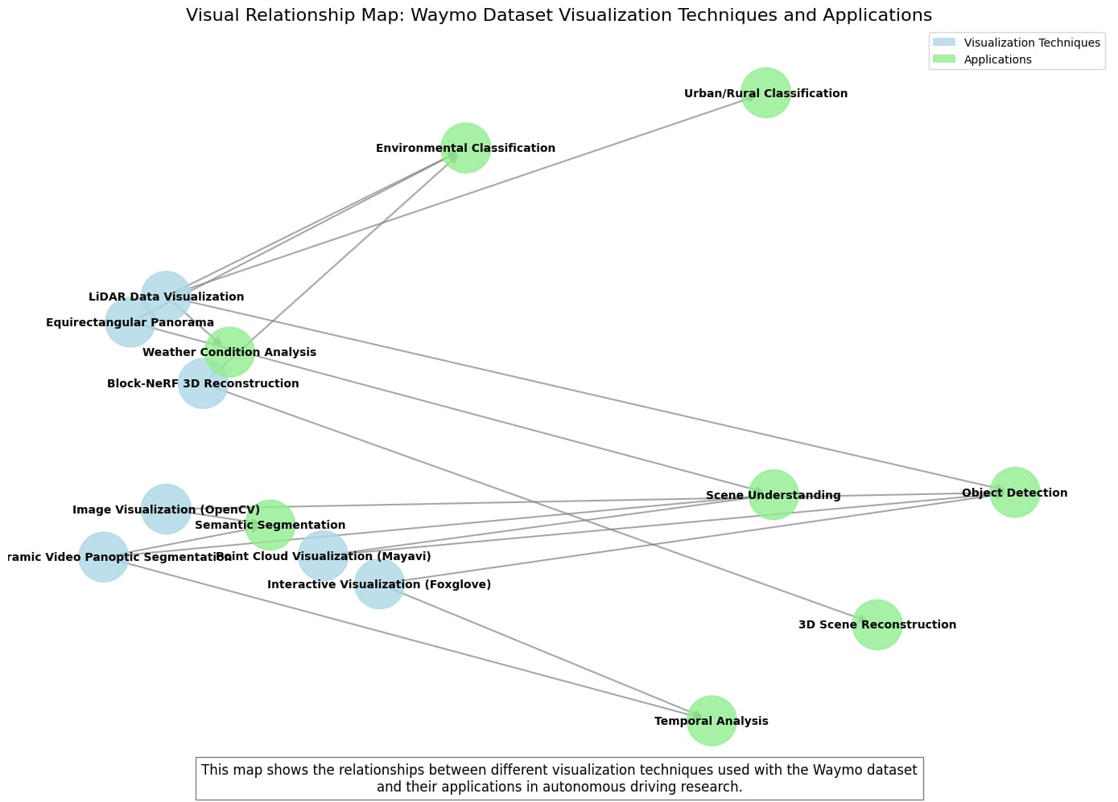

Slide 5
Problem Description
Autonomous driving systems require accurate scene understanding to ensure safety and performance.
Existing datasets, such as Waymo's, provide rich sensor data (camera images, LiDAR point clouds) but lack intuitive, interactive tools for effective scene classification and visualization.
Current visualization methods are often static or limited in interactivity, hindering comprehensive analysis and real-time insights.

Slide 6
Motivation
02

Slide 7
Motivation- Why Solve This Problem?
Enhance Autonomous Driving: Accurate scene classification directly improves decision-making capabilities of autonomous vehicles, enhancing safety and reliability.
Support Urban Planning & Research: Effective visualization tools aid urban planners and researchers in analyzing traffic patterns, infrastructure needs, and safety measures.
Leverage Rich Data: The Waymo dataset is extensive and diverse—ideal for developing advanced visualization techniques that can generalize across various driving conditions.
Innovation Potential: Opportunity to introduce innovative machine learning methods for extracting scene features and visualizing critical driving scenarios interactively.

Slide 8
Proposed Technical Approach
03

Slide 9
Proposed Technical Approach
Data preparation using the Waymo Open Dataset (camera images, LiDAR data).
Scene classification leveraging Python libraries (Pandas, Matplotlib) and machine learning models.
Interactive visualization development using Foxglove Studio:
- Custom panels for scene classification results.
- Statistical visualizations (heatmaps, bar charts).
- Advanced 3D point cloud visualizations.

Slide 10
Expected Outcomes
04

Slide 11
Expected Outcomes
Enhanced Scene Classification System: A comprehensive framework that accurately classifies driving environments (urban/rural, weather conditions) using multi-modal data from cameras and LiDAR.
Interactive Visualization Platform: A robust toolset built on Foxglove Studio that enables researchers and developers to dynamically explore and analyze autonomous driving scenarios.
Temporal Analysis Framework: Tools that track and visualize how scene characteristics evolve over time within driving sequences, providing insights into dynamic environments.
Critical Scenario Identification: Automated systems that identify and highlight potentially challenging driving scenarios for autonomous vehicles.
Integrated Multi-modal Visualization: A unified interface combining camera imagery, LiDAR point clouds, and semantic segmentation with classification overlays.
Accessible Dataset Utility: Tools that make the rich Waymo dataset more accessible and useful for the broader autonomous driving research community.
3D Scene Reconstruction: Accurate three-dimensional reconstructions of driving environments using Block-NeRF and other advanced visualization techniques.

